Slide 1
ER Diagram and Project Scheduling
of
DONORS CHOOSE

Slide 2
Group Members
180041208
Fida Kamal
180041214
Fariha Fairoz Nohan
180041229
Alvi Aveen Khan
‹#›/7

Slide 3
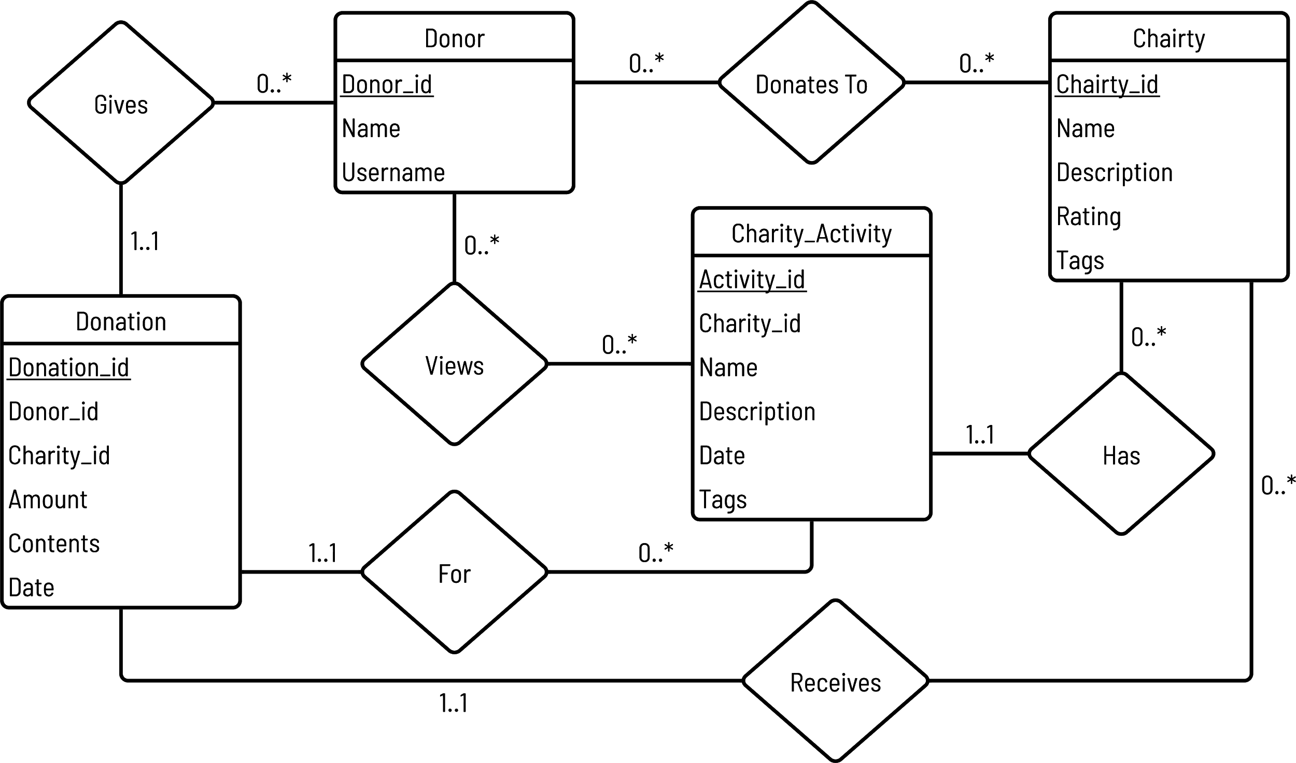
Entity-Relationship Diagram
‹#›/7

Slide 4
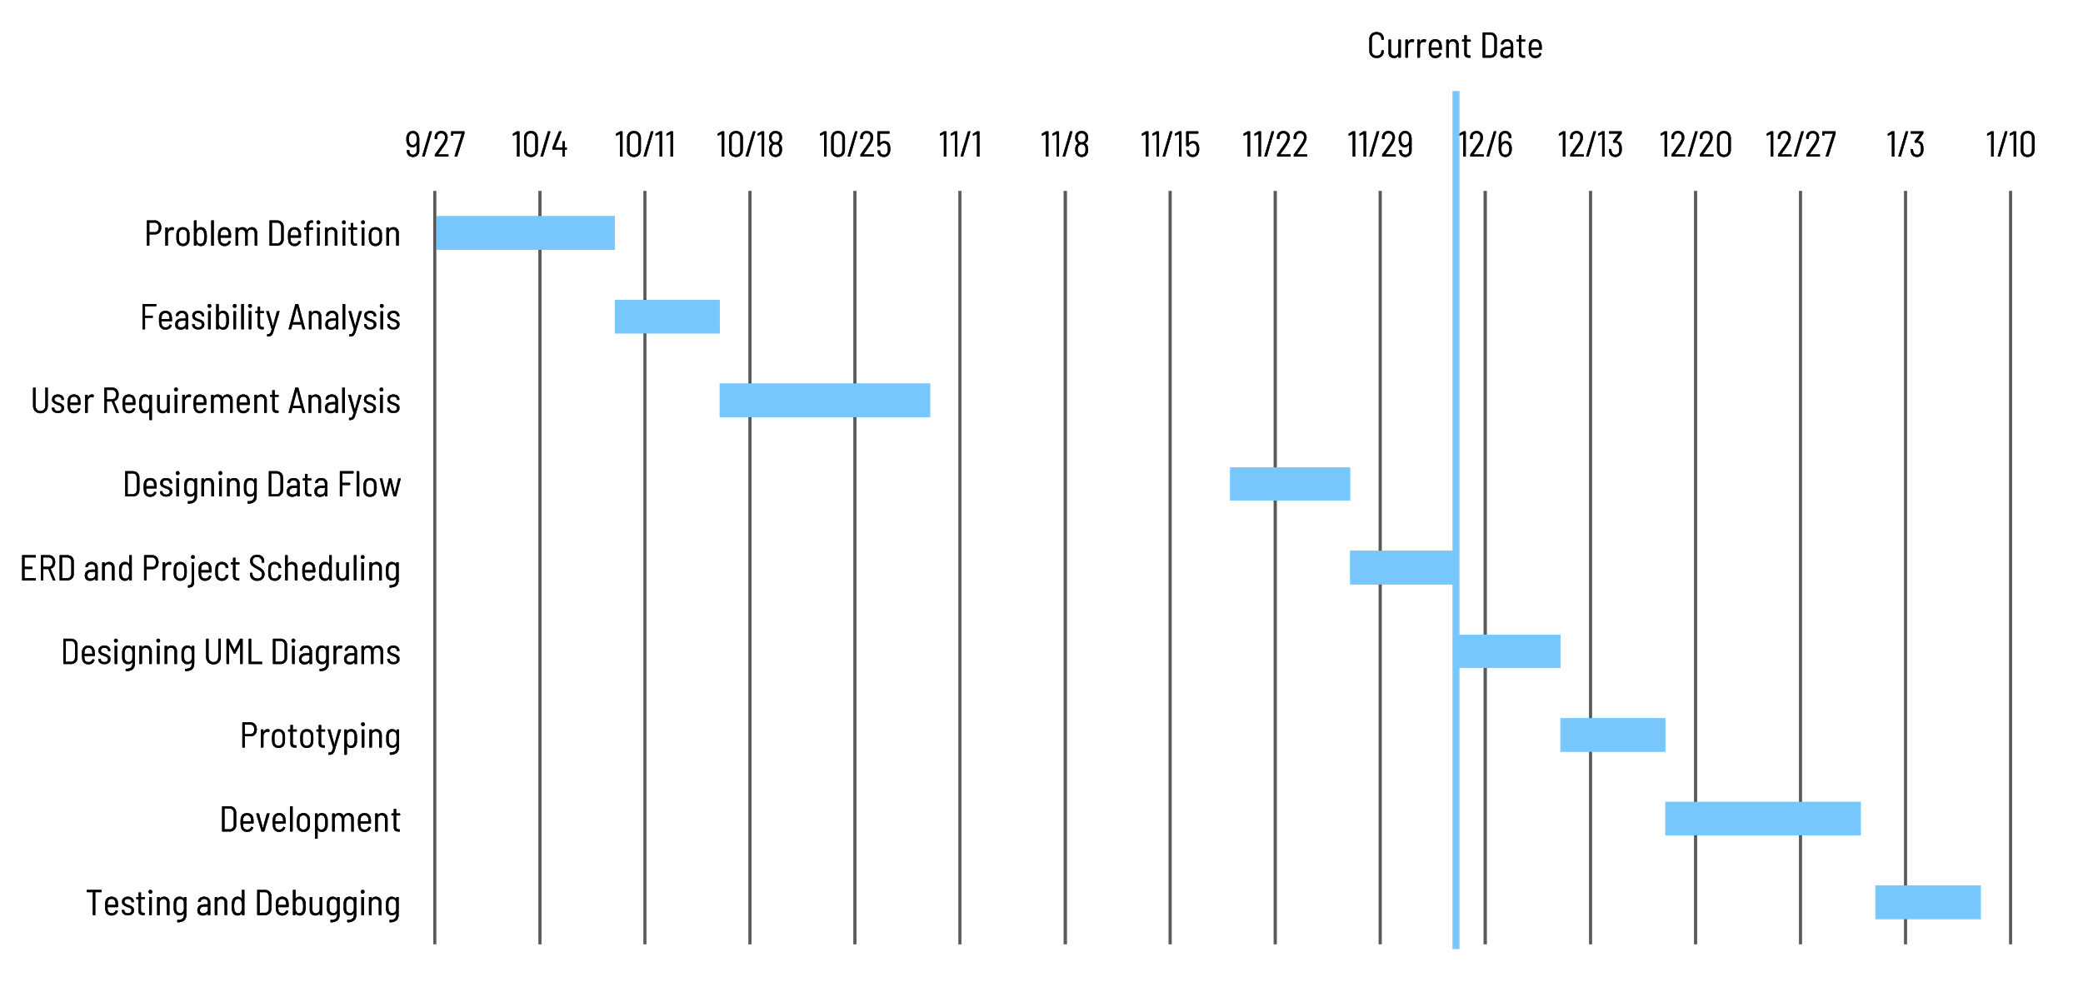
Gantt Chart
‹#›/7

Slide 5
THANK YOU!

